Slide 1


Deep learning with Keras
劉慈恩、李 方

Slide 2
Tutorial: stock prediction

Slide 3
Why Keras?
API designed for human beings
Write in Python
Can be build on different backends:
Tensorflow, Theano, CNTK
GPU available
Train simply and fast

Slide 4
Keras install: Python
Anaconda
https://www.anaconda.com/download/
Notes:
conda create –name創造環境
source activate name 用什麼環境執行

Slide 5
Keras install: CPU version
cmd / terminal
conda create -n py36 python=3.6
source activate py36
pip install tensorflow==1.5
pip install keras==2.2.0
Notes:
conda create –name創造環境
source activate name 用什麼環境執行

Slide 6
Keras install : GPU version
Check Nvidia GPU and CUDA support
https://developer.nvidia.com/cuda-gpus
Install CUDA
CUDA® Toolkit 9.0
https://developer.nvidia.com/cuda-90-download-archive
cuDNN v7.0
https://developer.nvidia.com/rdp/cudnn-download
pip install tensorflow-gpu==1.5

Slide 7
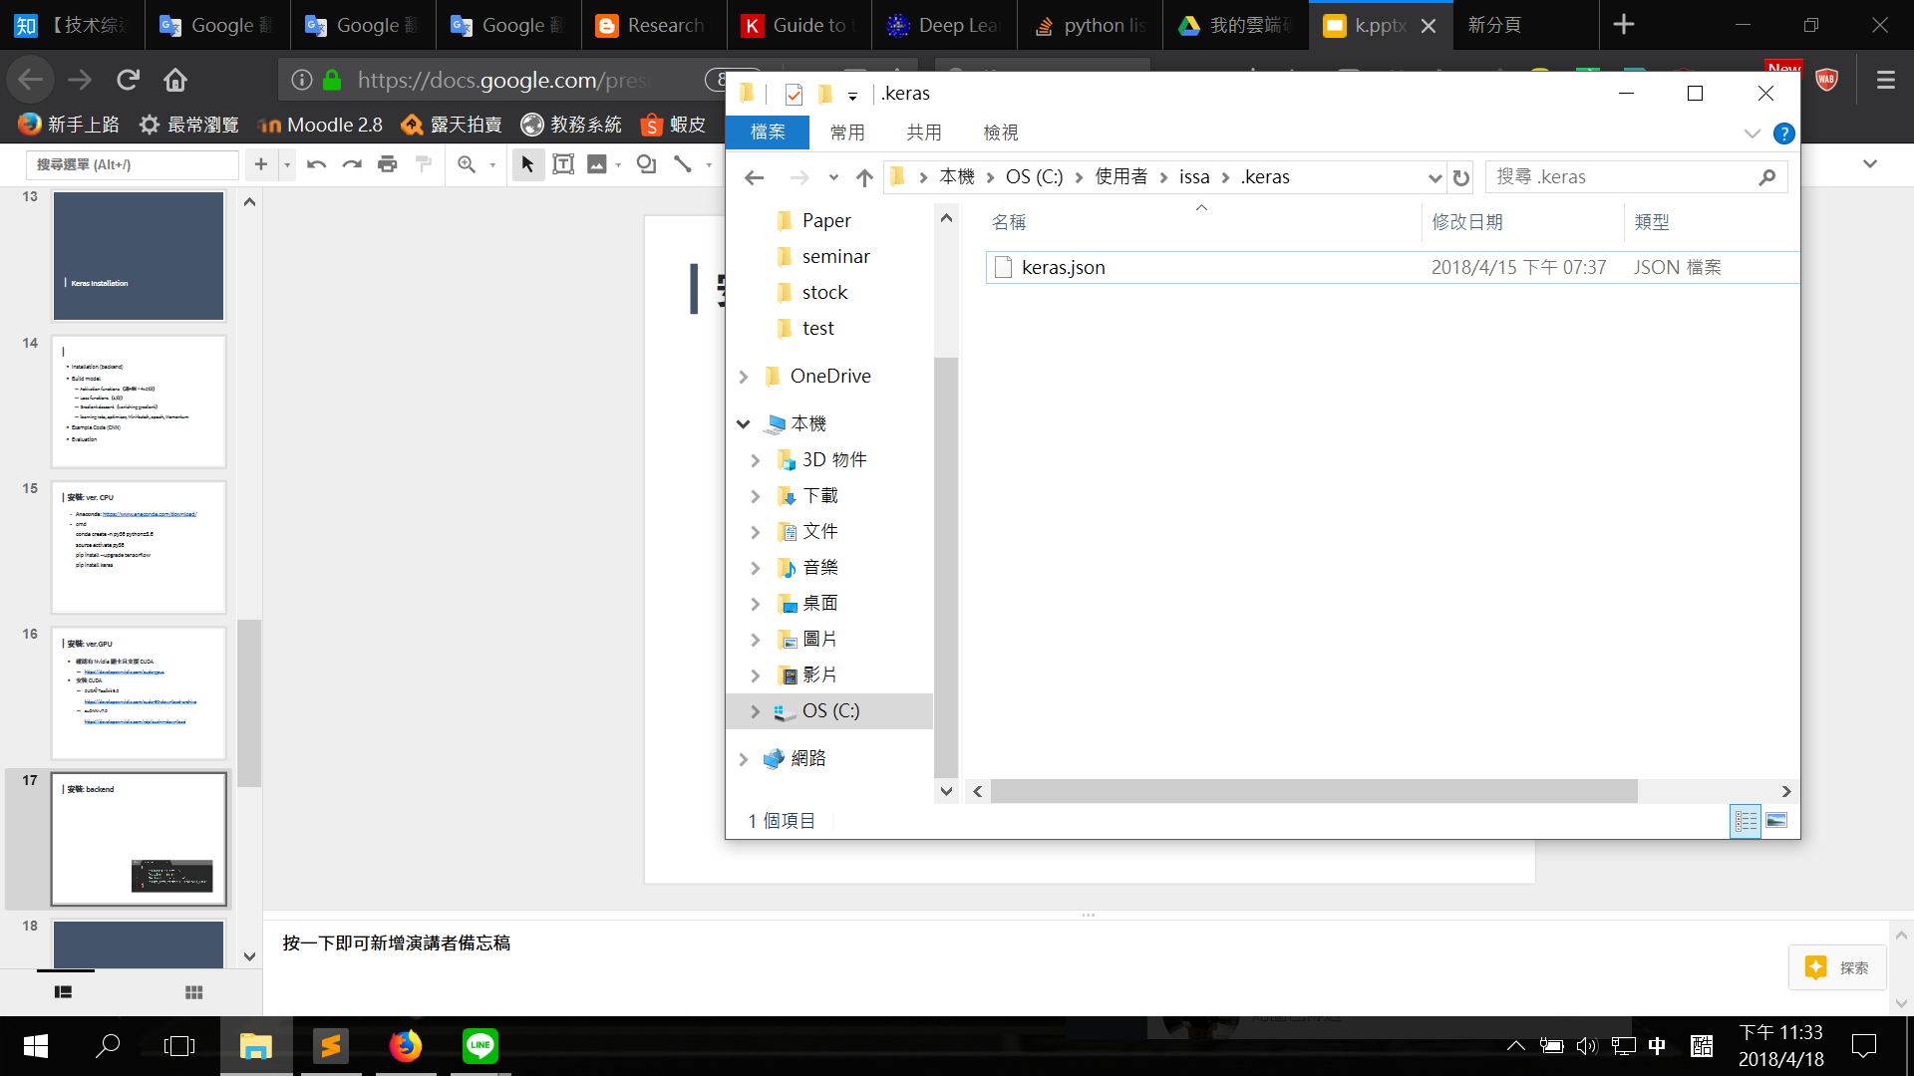
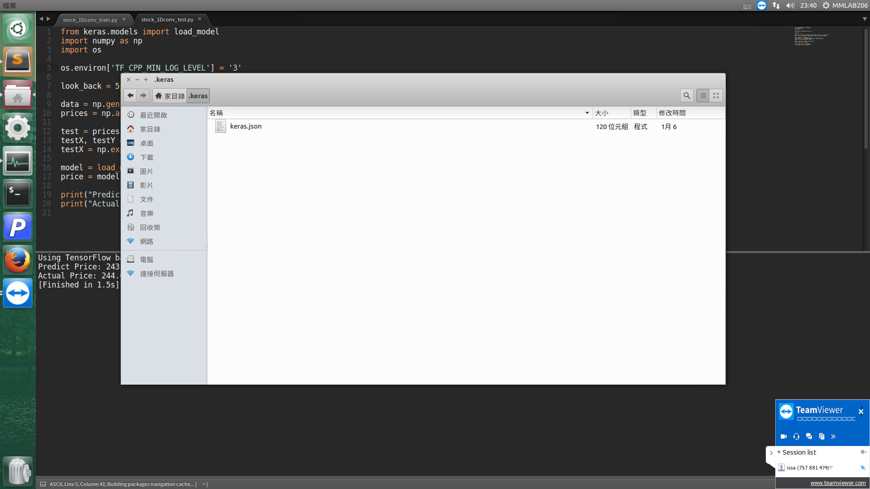
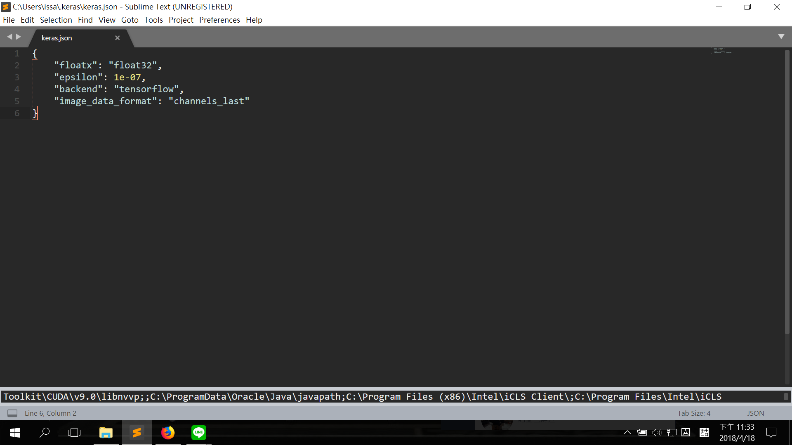
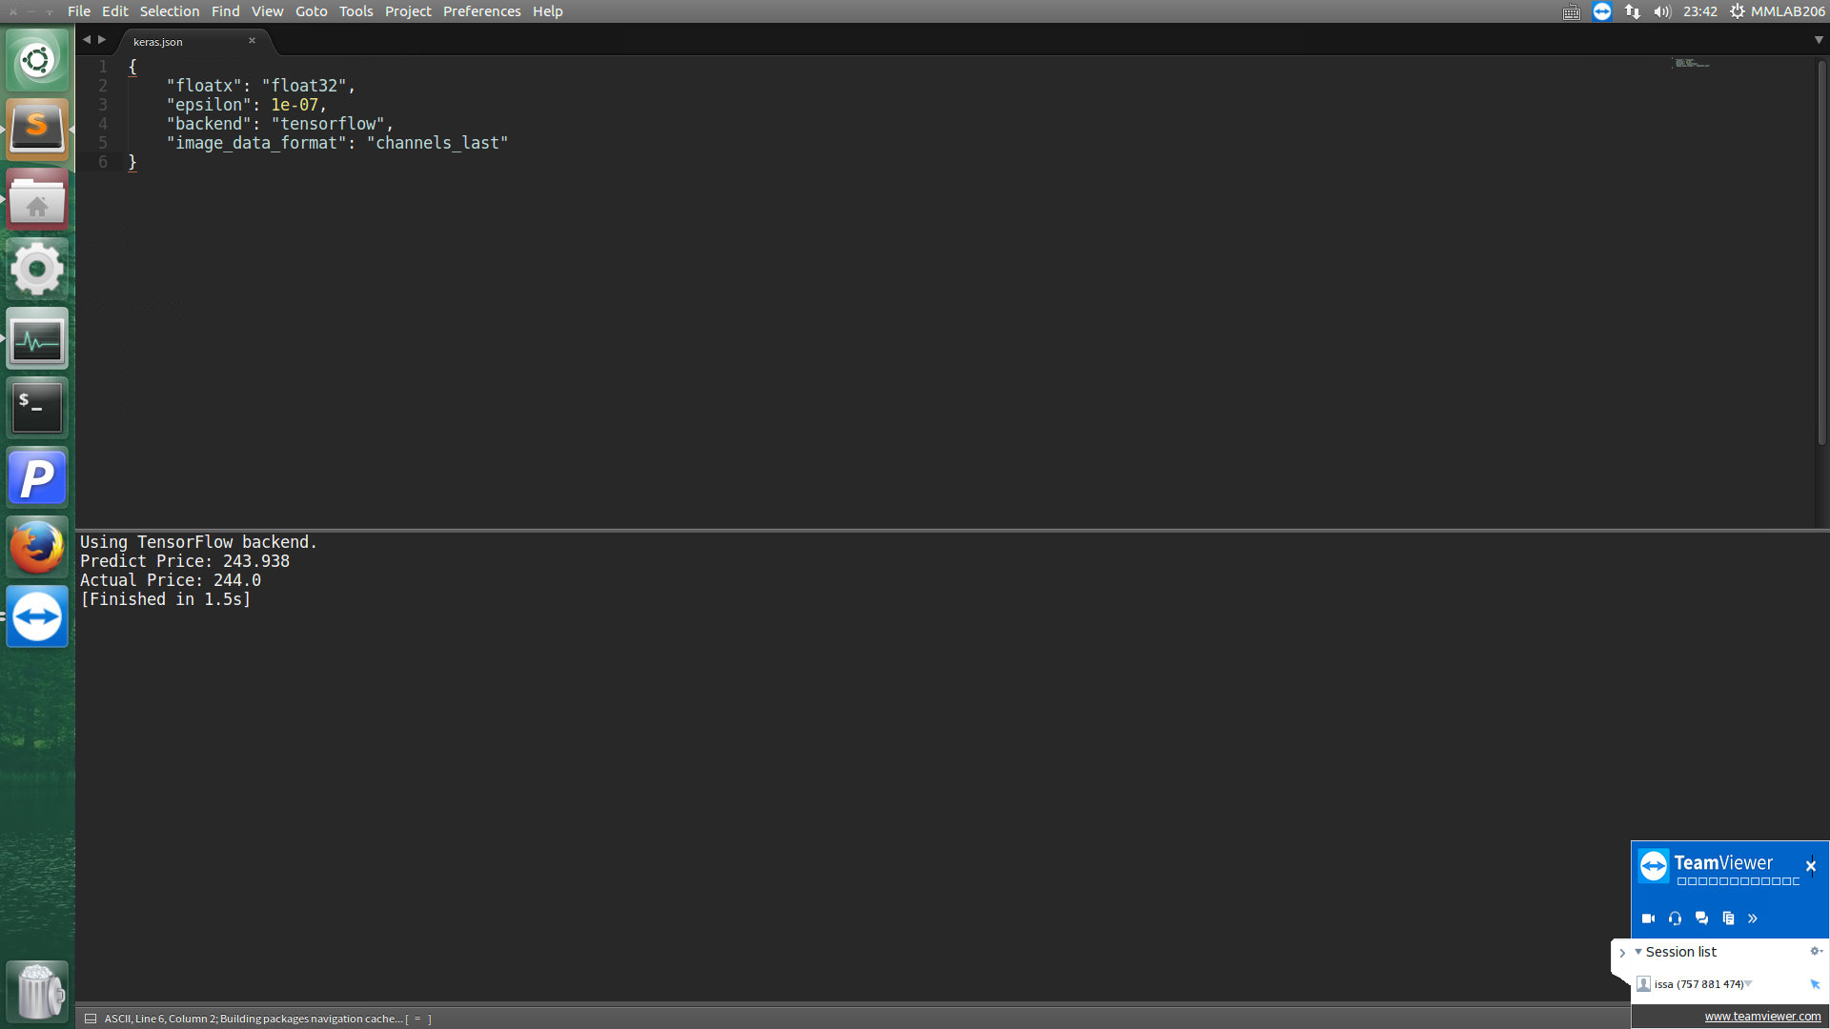
Keras install : backend
Modify the backend
Path:
C:\Users\user-name\.keras(win)、 ~/.keras(linux)
Win
Linux

Slide 8
Google Colab
Free GPU and RAM
Protable
Jupyter Notebook
Share with your team

Slide 9
Datasets
2003/9/24, 14.74
2003/9/25, 15.76
.
.
2021/2/26, 126
2021/3/2, 127.5
6269.csv
Flexium stock data
period: 2003/9/24 - 2021/3/2
date (yyyy/mm/dd)
open/high/low/close price (float)
2003/9/24, 5704.00
2003/9/25, 5634.25
.
.
2021/2/26, 16190.04
2021/3/2, 16127.87
stock_index.csv
market data
date (yyyy/mm/dd)
open/high/low/close price (float)

Slide 10
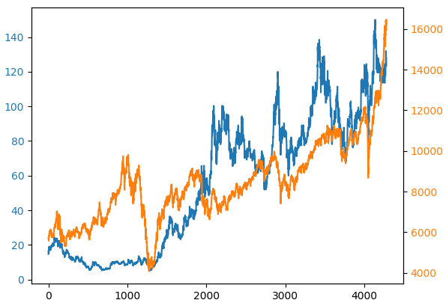
Datasets: Visualization

Slide 11
Data Preprocessing: split data
Import numpy as np
# Read file
data = np.genfromtxt('./dataset/2409.csv', delimiter=',', dtype=None)[1:]
#prices = np.array([close for date, open, high, low, close in data]).astype(np.float64)
date = data[:, 0] # first column
open = data[:, 1]
high = data[:, 2]
low = data[:, 3]
close= data[:, 4]
prices = np.array(close).astype(np.float64)
# Split trainset and testset
# Ratio: 8(training): 2(testing)
train_size = int(len(prices) * 0.8)
train, test = prices[:train_size], prices[train_size:]

Slide 12
Data Preprocessing: Sequential Data
input: N days as training sample
output: 1 day as groundtruth
raw data
[ 37.62
37.62
40.19
.
.
7.35
7.45
7.97 ]
input
[
[37.62, 37.62, 40.19, 39.05, 38.48],
[37.62, 40.19, 39.05, 38.48, 39.05],
.
.
[7.37, 7.41, 7.07, 7.33, 7.35]
[7.41, 7.07, 7.33, 7.35, 7.45]
]
output
[
[39.05],
[37.91],
.
.
[7.45]
[7.97]
]

Slide 13
Data Preprocessing: Sequential Data
def transform_dataset(dataset, look_back=1):
# N days as training sample
dataX = [dataset[i:(i + look_back)]
for i in range(len(dataset) - look_back - 1)]
# 1 day as groundtruth
dataY = [dataset[i + look_back]
for i in range(len(dataset) - look_back - 1)]
return np.array(dataX), np.array(dataY)
# Set N(look_back) = 5
look_back = 5
trainX, trainY = transform_dataset(train, look_back)
testX, testY = transform_dataset(test, look_back)

Slide 14
Building Model in Keras
Define Model
Define neurons of every hidden layer
Define the activation function
Compile Model
Define loss function and optimizer
Parameters: learning rate, momentum…
Fit Model
Let model view data

Slide 15
Define Model
Define Model
Define neurons of every hidden layer
Define the activation function
Compile Model
Define loss function and optimizer
Parameters: learning rate, momentum…
Fit Model
Let model view data

Slide 16
Define Model
You want to build:
Input (5)
Hidden layer(64)
Output (1)

Slide 17
Define Model
Input (5)
Input 5 samples an a time
1 hidden layer with 64 neurons
Output 1 prediction
(64)
Output (1)
Let’s translate it into keras codes!

Slide 18
Define Model
from keras.models import Sequential
# Define a Sequential Model
model = Sequential()

Slide 19
Define Model: Layers
from keras.models import Sequential
from keras.layers import Dense
# Define a Sequential model
model = Sequential()
# Add 1 dense layer to model
model.add(Dense(units=64))
# dense layer = fully connected layer
# units = number of neurons = 64

Slide 20
Define Model: Layers
from keras.models import Sequential
from keras.layers import Dense
# Define a Sequential model
model = Sequential()
# input_dim = the dimension of input data
# Set the input_dim hidden layer as 5
model.add(Dense(units=64,
input_dim=5))

Slide 21
Define Model: Layers
from keras.models import Sequential
from keras.layers import Dense
# Define a Sequential model
model = Sequential()
# input_dim = the dimension of input data
# Set the input_dim hidden layer as 5
model.add(Dense(units=64,
input_dim=5))
# Add output layer: dense layer with only 1 neuron
model.add(Dense(units=1))

Slide 22
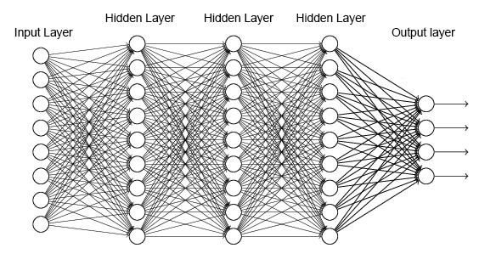
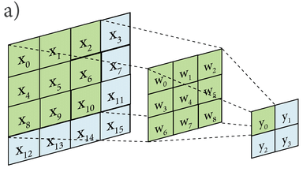

Define Model: Layers
Core layer (常用層)
Dense: fully-connected layer
Activation: activation function
Flatten: transform N-dim input into 1-dim output.
Drop: remove input unit (neuron) randomly.
Convolution layer (卷積層)
Conv1D, Conv2D, Conv3D…
Recurrent Layer (遞迴層)
RNN, LSTM

Slide 23
Define Model: Layers
Your idea
Your code
from keras.models import Sequential
from keras.layers import Dense
# build a sequential model
model = Sequential()
# input and hidden layer
model.add(Dense(units=64,
input_dim=5))
# output layer
model.add(Dense(units=1))
Input (5)
(64)
Output (1)

Slide 24

似乎少了點什麼？
所以那個 activation function 呢？

Slide 25
Define Model: Activation Function
from keras.models import Sequential
from keras.layers import Dense
# build a sequential model
model = Sequential()
# input and hidden layer
model.add(Dense(units=64,
activation=‘relu’,
input_dim=look_back))
# output layer
model.add(Dense(units=1))
Choose:
Sigmoid
Tanh
ReLU
Softmax

Slide 26
Define Model: Activation Function
from keras.models import Sequential
from keras.layers import Dense
# build a sequential model
model = Sequential()
# input and hidden layer
model.add(Dense(units=64,
activation=‘relu’,
input_dim=look_back))
# output layer
model.add(Dense(units=1))
Choose:
Sigmoid
Tanh
ReLU
Softmax
Notes:
Softmax適用多個答案(multi-label)

Slide 27
Activation Function
Nonlinear
Limit output values
Common: Sigmoid, tanh, ReLU, Softmax
Notes:
比較常見的有以下四種
之後會逐一介紹

Slide 28
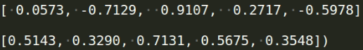
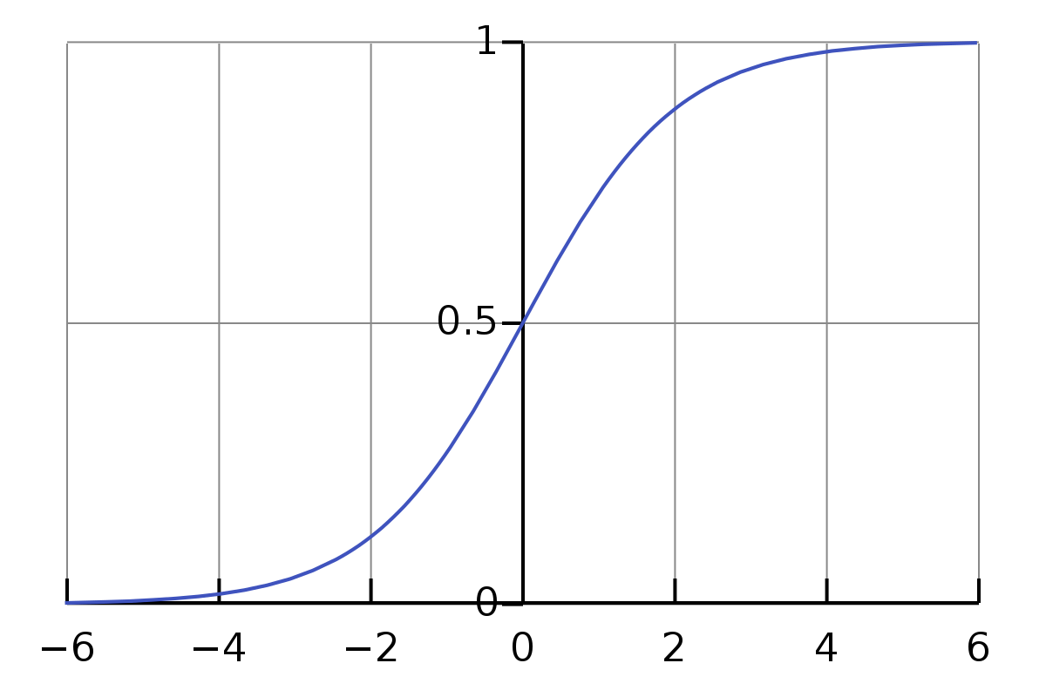
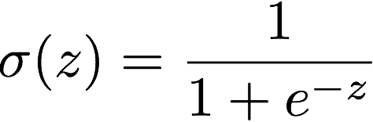
Activation Function: Sigmoid
Range: [0, 1]
Differentiable
Monotonic before differentiation

Slide 29
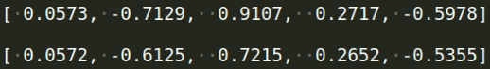
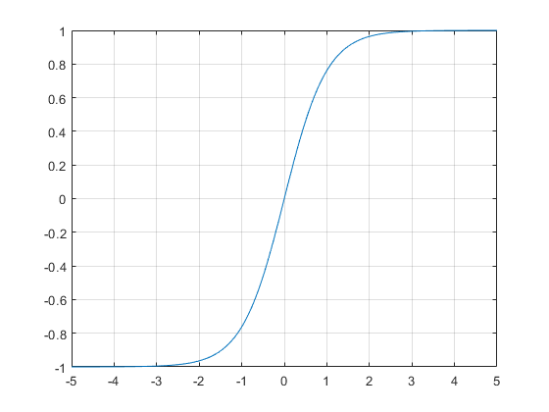
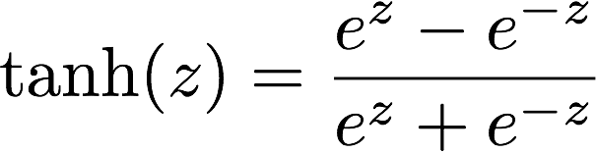
Activation Function: tanh
Range: [-1, 1]
Differentiable
Monotonic before differentiation

Slide 30
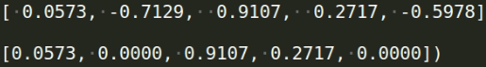
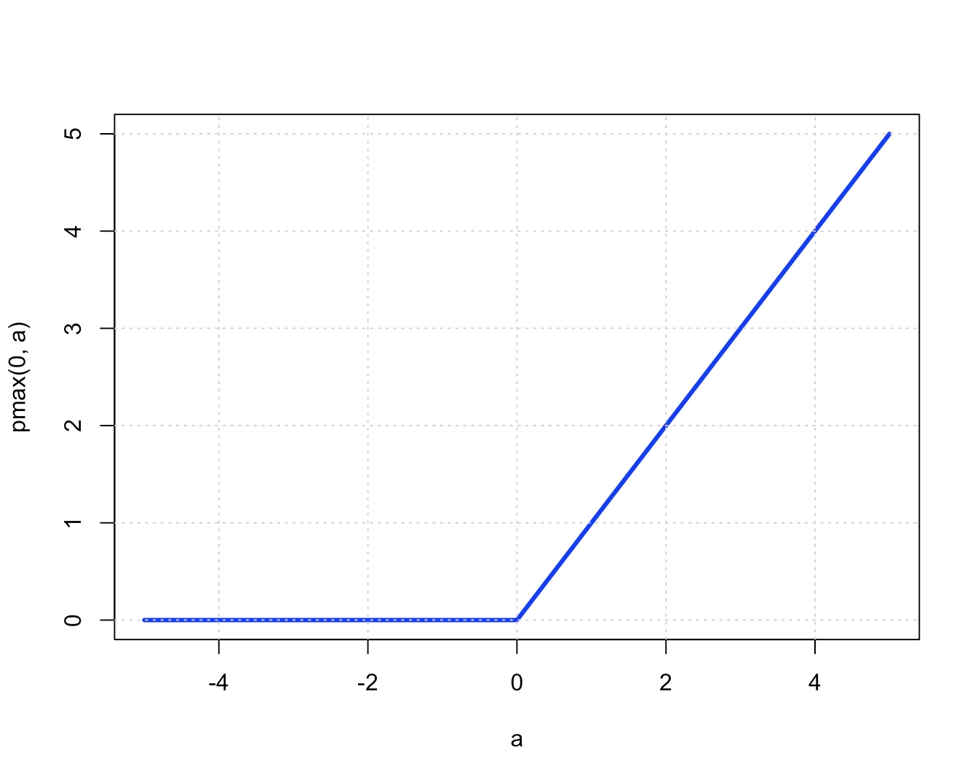
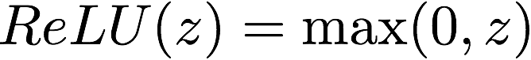
Activation Function: ReLU
Range: [0, infinity)
Differentiable
Monotonic before and after differentiation

Slide 31
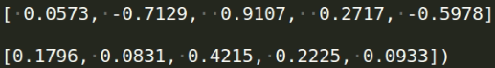
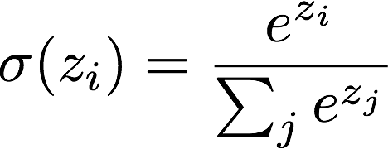
Activation Function: Softmax
Range: [0, 1]
For classification
Probability of every class
Sum = 1
Class 1 | 0.1
Class 2 | 0.005
Class 3 | 0.7
Class 4 | 0.145
Class 5 | 0.05

Slide 32
Define Model: Activation Function
如何挑選醬汁 Tips
sigmoid: suit for simple network
Tanh: suit for RNN
ReLU : suit for CNN
softmax: last layer for classification output

Slide 33
Compile Model
Define Model
Define neurons of every hidden layer
Define the activation function
Compile Model
Define loss function and optimizer
Parameters: learning rate, momentum…
Fit Model
Let model view data

Slide 34
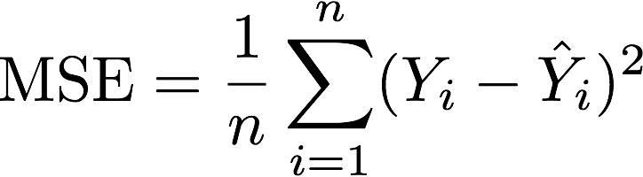
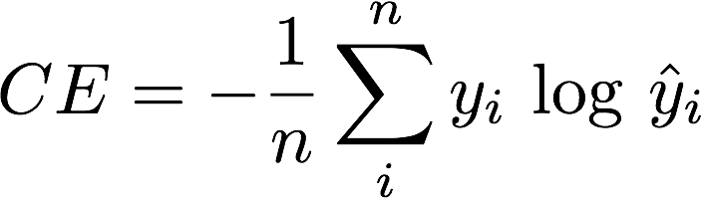
Compile Model: Loss Function
AKA Objective function
Measure the difference between predict and ground-truth
Common loss functions:
Mean Squared Error (Regression)
Cross Entropy (Classification)

Slide 35

Compile Model: Loss Function
Measure the difference between predict and ground-truth
Rule: 1 for correct, 0 for wrong.
cat
+1
dog
+0

Slide 36

Compile Model: Loss Function
Measure the difference between predict and ground-truth
Rule: higher points for higher similarity (0~1)
cat
+0.8
dog
+0.1

Slide 37
Compile Model: Loss Function
Measure the difference between predict and ground-truth
For your reference:
Classification + cross entropy
Regression + Mean Squared/Absolute Error

Slide 38
Compile Model: Loss Function
from keras.models import Sequential
from keras.layers import Dense
# build a sequential model
model = Sequential()
# a hidden layer with 64 neurons and a output layer
model.add(Dense(units=64, activation=‘relu’, input_dim=look_back))
model.add(Dense(units=1))
# set loss function
model.compile(loss='mse’)

Slide 39
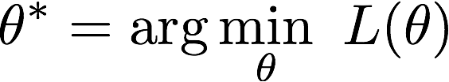

Compile Model: Optimizer
Goal: find the best model to minimum loss
Optimize loss function:
strategy to find minimum loss
Strategy:
SGD
RMSprop
Adam

Slide 40
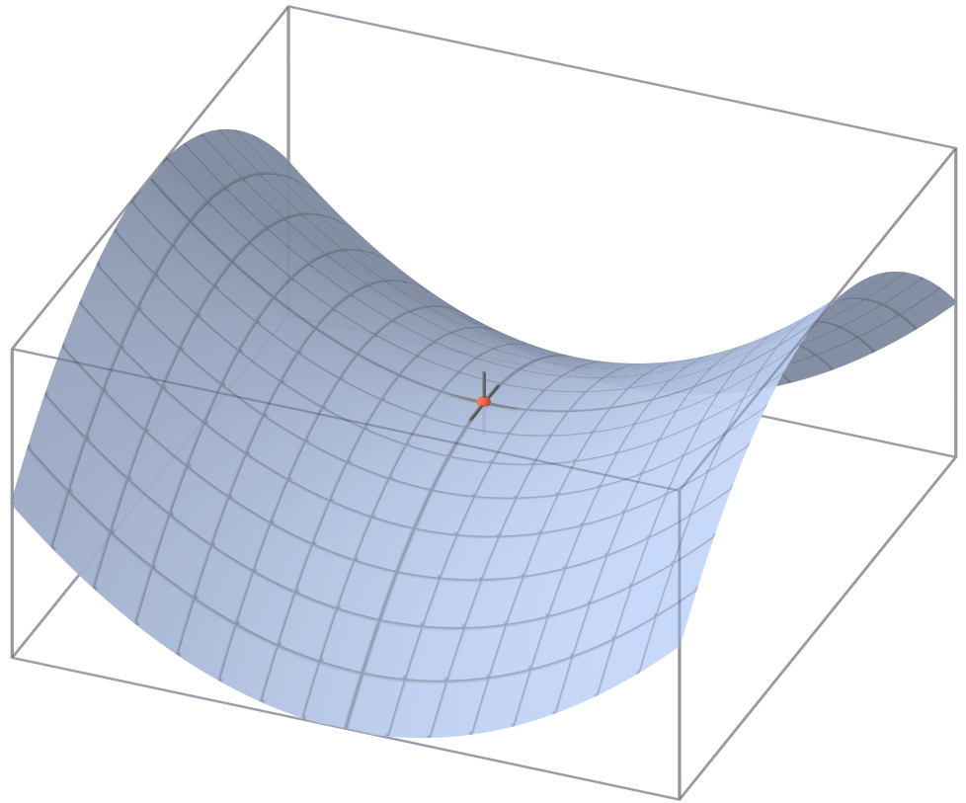
Compile Model: Optimizer
SGD
Good starter
Converge slowly, stuck into saddle point easily
Accelerate by changing learning rate and momentum
Notes:
pic ref: Wikipedia of saddle point

Slide 41
Compile Model: Optimizer
RMSprop
for RNN
Adam
Performs well in most situations.
Mostly, model performs well with default parameters.

Slide 42
Compile Model: Optimizer
from keras.models import Sequential
from keras.layers import Dense
# build a sequential model
model = Sequential()
# a hidden layer with 64 neurons and a output layer
model.add(Dense(units=64, activation=‘relu’, input_dim=look_back))
model.add(Dense(units=1))
# set optimizer
model.compile(loss='mse’,
optimizer='adam’)

Slide 43
Fit Model
Define Model
Define neurons of every hidden layer
Define the activation function
Compile Model
Define loss function and optimizer
Parameters: learning rate, momentum…
Fit Model
Let model view data

Slide 44
Fit Model
x, y
Training data and its label
validation data
To evaluate model performance
2 ways: training, validation, test 2 ways: training, test
shuffle
Break the order of data
It is recommended that shuffling train/valid data on your own

Slide 45
Fit Model
epoch
How many times for viewing all the training data
batch_size
How many samples that model views in a time
verbose
Show the training progress
0: dismiss; 1: by every batch; 2: by every epoch

Slide 46
Fit Model
from keras.models import Sequential
from keras.layers import Dense
# build a sequential model
model = Sequential()
# a hidden layer with 64 neurons and a output layer
model.add(Dense(units=64, activation=‘relu’, input_dim=look_back))
model.add(Dense(units=1))
# loss function and optimizer
model.compile(loss='mse’, optimizer='adam’)
# fit data
train_history = model.fit(trainX, trainY,
epochs=100, batch_size=5, shuffle=False, verbose=2
validation_data=(testX, testY))

Slide 47
Save model
from keras.models import Sequential
from keras.layers import Dense
# build a sequential model
model = Sequential()
model.add(Dense(units=64, activation=‘relu’, input_dim=look_back))
model.add(Dense(units=1))
model.compile(loss='mse’, optimizer='adam’)
# train
train_history = model.fit(trainX, trainY,
epochs=100, batch_size=5, shuffle=False, verbose=2
validation_data=(testX, testY))
# save model and parameters
model.save('stock_DNN_model.h5')

Slide 48
Load Model
from keras.models import load_model
# load model
model = load_model('./stock_DNN_model.h5’)

Slide 49
Evaluate Model
from keras.models import load_model
# load model
model = load_model('./stock_DNN_model.h5’)
# test data
test = model.evaluate(testX, testY, batch_size=5)
print(“Test Result: ”, test)
Test Result: 6.832
# show the difference between predict and groundtruth (loss)

Slide 50
Predict Model
From keras.models import load_model
# load model
model = load_model(‘./stock_DNN_model.h5’)
# predict data
predict = model.predict([[7.41, 7.07, 7.33, 7.35, 7.45]])
print(“Predict Result”, predict)
Predict Result: 247.01
# show the model prediction

Slide 51
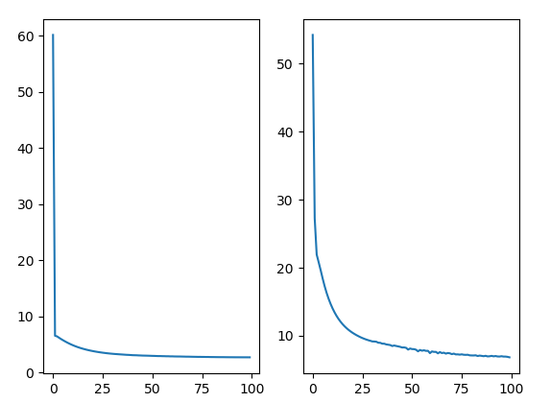
Visualization Result
import matplotlib.pyplot as plt
# Visualize
loss = train_history.history['loss’]
val_loss = train_history.history['val_loss’]
plt.subplot(121)
plt.plot(loss)
plt.subplot(122)
plt.plot(val_loss)
plt.show()
loss
val_loss
epoch
epoch
Epoch increases, both loss and val_loss decrease.

Slide 52
Overfitting
from keras.models import Sequential
from keras.layers import Dense, Conv1D, Flatten
# build a sequential model
model = Sequential()
model.add(Conv1D(filters=256, kernel_size=2, activation='relu', input_shape=(5, 1)))
model.add(Conv1D(filters=128, kernel_size=2, activation='relu’))
model.add(Flatten())
model.add(Dense(units=1))
model.compile(loss='mse', optimizer='adam’)
train_history = model.fit(trainX, trainY,
epochs=100, batch_size=5, validation_data=(testX, testY),
verbose=2)

Slide 53
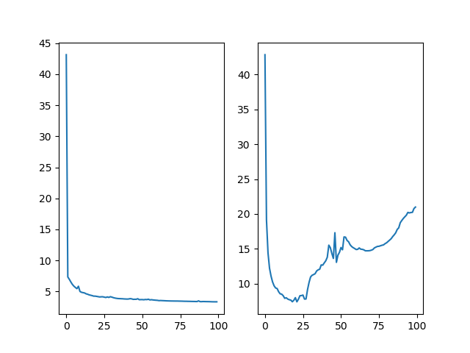
Overfitting
loss
val_loss
迭代次數
迭代次數
Loss decreases but val_loss increases.

Slide 54
Keep an eye on your model!

Slide 55
Overfitting
Early stopping
Drop out: remove some neurons randomly.

Slide 56
What’s more we can do?
Add layers; remove layer neurons; set another parameter
Change input dimension
Build another model
RNN, LSTM
Use [stock_index.csv] for more information
Build a model for viewing both data in a time
And other good ideas from you!

Slide 57
Check keras official website
https://keras.io
Details of a function or object. Default parameters, returns, data types, … and so on. (而且 keras 很貼心有中文版)

Slide 58
Q & A

Slide 59
Reference

Slide 60
Reference
Goodfellow, I., Bengio, Y., Courville, A., & Bengio, Y. (2016). Deep learning (Vol. 1). Cambridge: MIT press.
手把手的深度學習實務 https://www.slideshare.net/tw_dsconf/ss-70083878
Deep Learning TV https://www.youtube.com/watch?v=b99UVkWzYTQ&list=PLjJh1vlSEYgvGod9wWiydumYl8hOXixNu
Keras 官方文件 https://keras.io

